Slide 1
Employee attrition
Team X –
Amy McVicar, Angela Garcia, Jennifer mead, Jon lee

Slide 2
The business problem
When an employee quits, it costs time and money to replace them.
If you’ve invested in training and developing an employee, that investment ends when they leave.
Can we predict who is likely to quit so that we can intervene?
Can we advise the business on how to develop programs to keep employees?

Slide 3
Our approach
The business problem
Our data
Exploratory data analysis
Models
ARM
Clustering
Decision trees
KNN
Naïve Bayes
SVM
Random Forest
Comparing models, comparing attributes
Conclusions and next steps

Slide 4
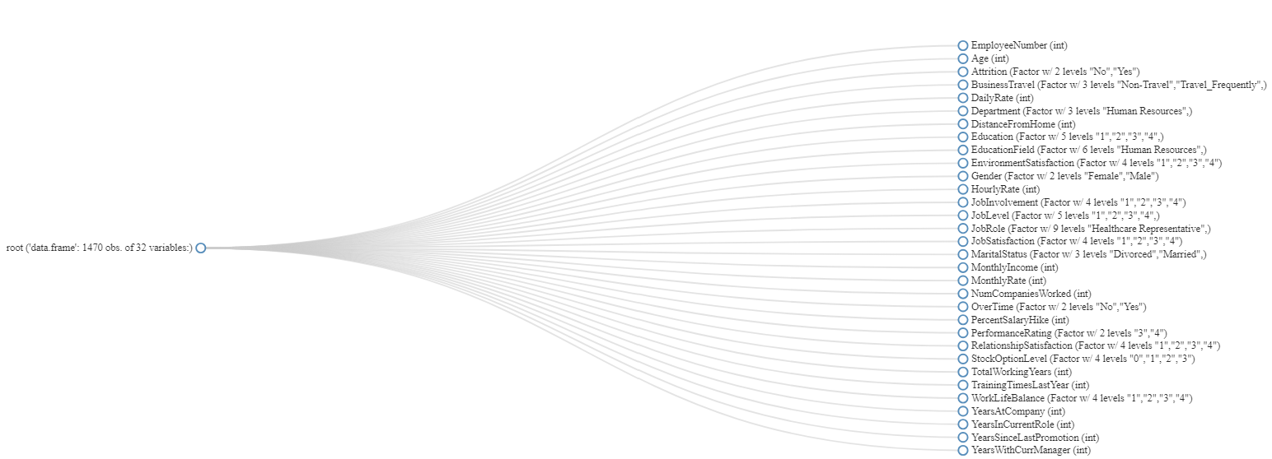
OUR DATA
Source:
https://www.kaggle.com/pavansubhasht/ibm-hr-analytics-attrition-dataset
Cleaning:
Check for NA
Remove EmployeeCount, Over18, StandardHours
Change names and types
Notes:
AMY
Now that the data is clean, the next stage of the project is exploratory data analysis.
We now have 32 columns to work with.

Slide 5
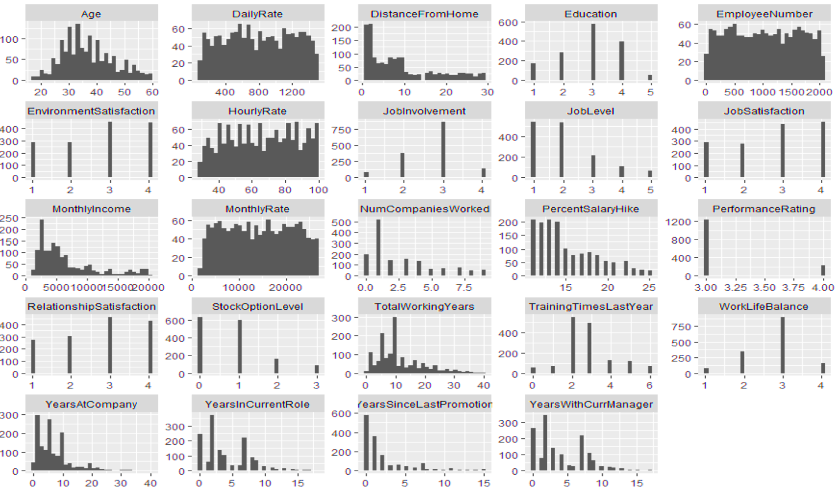
Notes:
AMY
The next step was to look at histograms of all numeric variables to identify which should be categorical instead.
Histograms with parallel lines instead of distributions with close bins are typically factors. It looks like the following columns are actually factors instead of integers. Some models need numerical inputs and some need factors, but at this stage of our project we converted them to factors.
BUILD
Based on the histogram results, we converted nine (9) columns to factors. This matches the initial report we ran that identified 9 discrete columns.
The columns converted to factors at this stage were:
* Education
* EnvironmentSatisfaction
* JobInvolvement
* JobLevel
* JobSatisfaction
* PerformanceRating
* RelationshipSatisfaction
* StockOptionLevel
* WorkLifeBalance

Slide 6
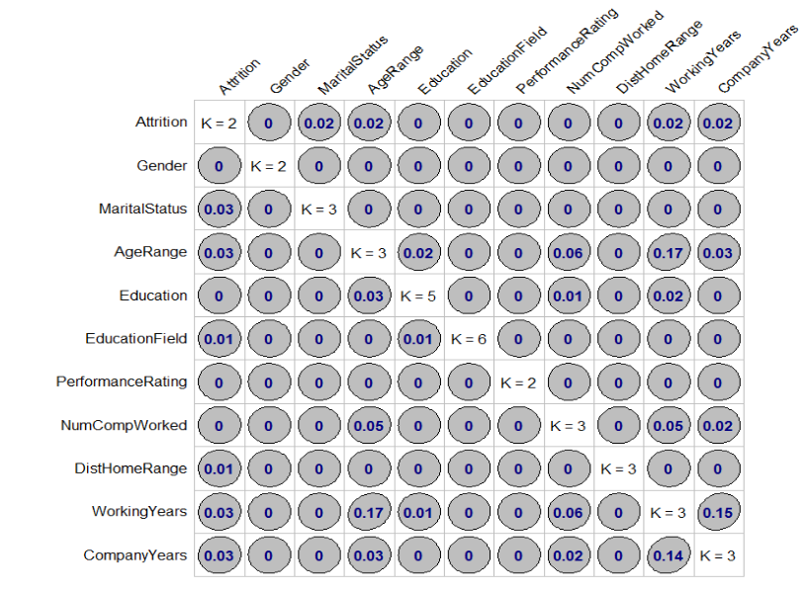
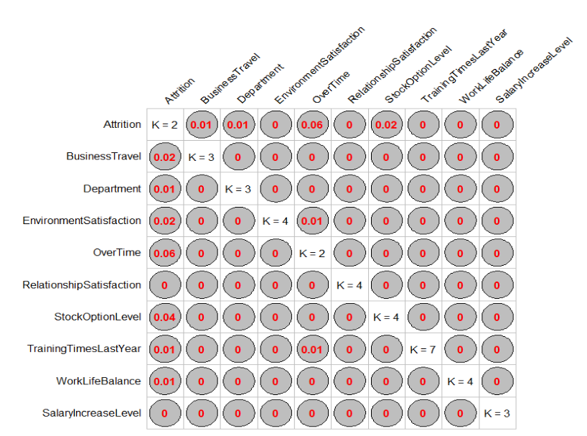
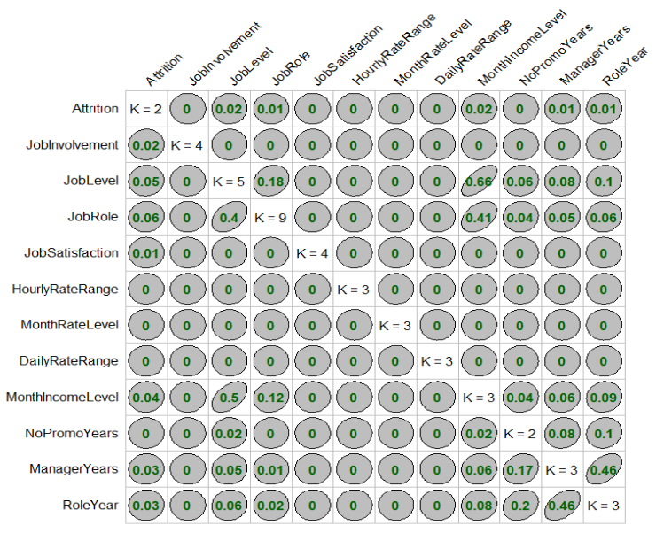
Goodman and Kruskal tau measure
Association Analysis for Categorical Variables
Person-Profile
Company
Role-Job
Low associations to Attrition.
Highest ones:
Age Range-Working Years
Working Years -Years in Company
Low associations in general Highest one. Attrition and Overtime at 0.06
Low associations to attrition. Other attributes highest associations : job level and job role to Monthly Income level and time in a role to time with a manager
Notes:
This model is used to establish association of categorical values (similar to correlation for numerical data) In order to make these associations easier to visualize, we grouped the attributes in 3 groups and compared them to Attrition.
These groups are:
Person/Profile: Attributes that have to do with the employee. It includes Gender, Marital Status, Age, Education, Education Field, Performance Rating, Number of companies worked for, Distance from Home, Working Years and Company years
Company: Attributes associated to company policy and rules. It included Business travel, Department, Overtime, Environment Satisfaction, , Relationship Satisfaction, Stock option levels, training, work life balance and salary increase level
Role/Job: Attributes in reference to the role or job performed: Job Involvement, Job Level, Job Role, Job Satisfaction, Hourly Rate, Monthly rate and Income, Daily rate, Years without a promotion, years with the current manager and time in the current role
In terms of the Association of the different attributes to Attrition, Person-Profile attributes have a low association to attrition (MAX OF 0.02) Other associations are also low with the highest values at 0.17 and 0.16 for Age to Working Years (No surprise) and Working-Years and Company Years
Company attributes have a low association to attrition (MAX OF 0.06)
Role-Job attributes have also low associations to attrition. For other attributes the highest associations are job level and job role to Monthly Income level and time in a role to time with a manager

Slide 7
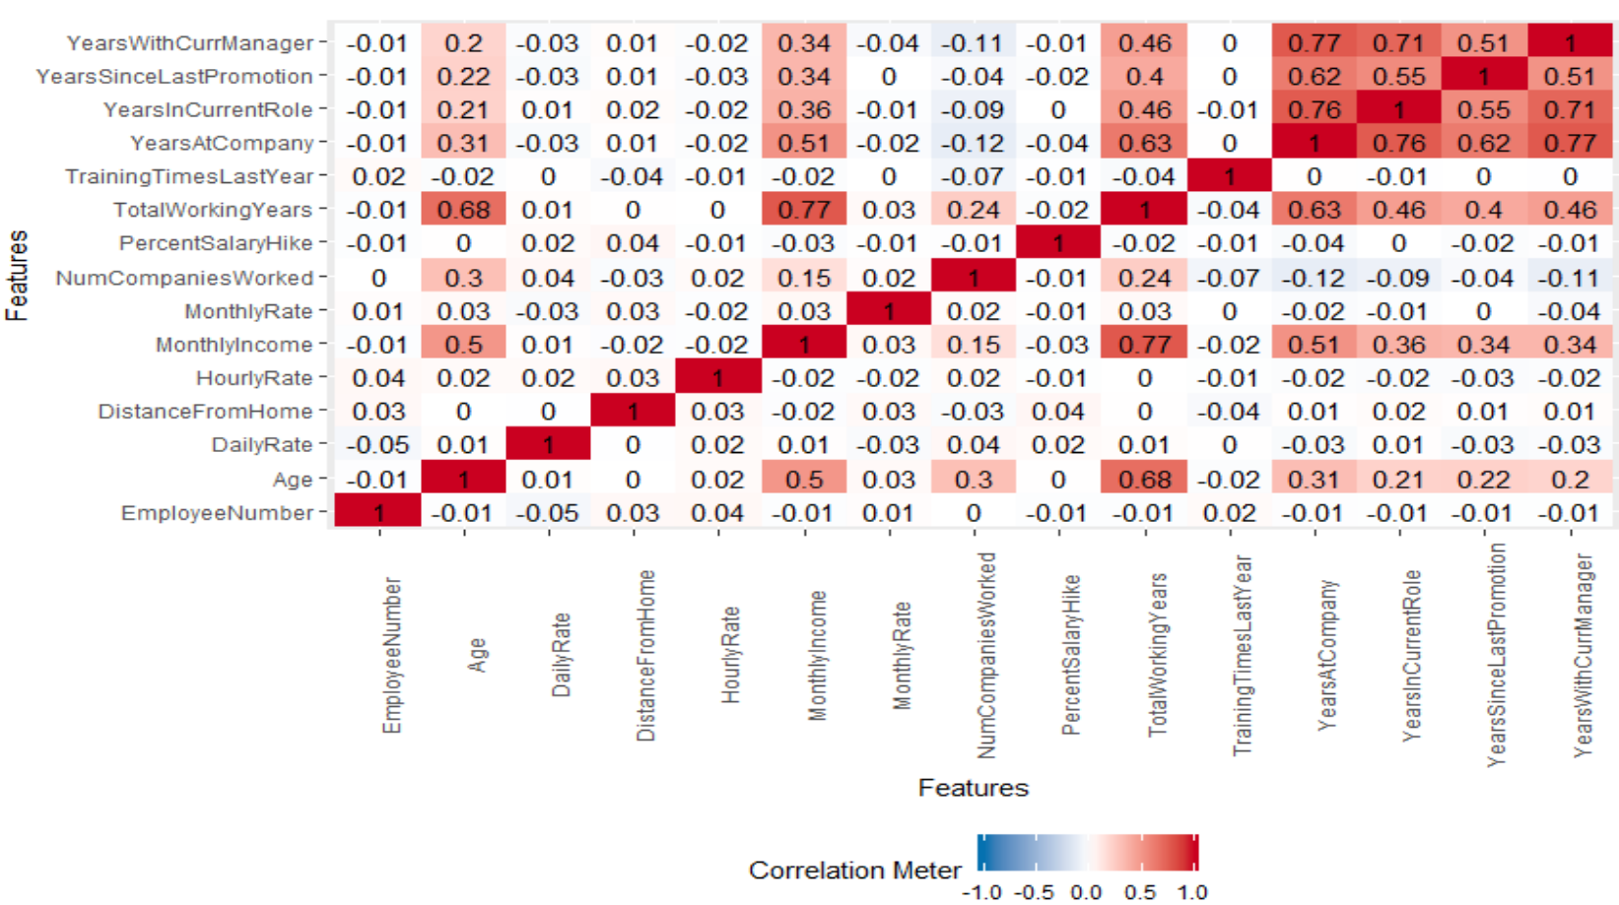
Notes:
From correlating the attributes we can see pockets of correlation.
BUILD
Most notably are:
Years with Current Manager
Years Since Last Promotion
Years in Current Role
Years at Company
BUILD
And no surprise, these correlate with Age, Income, and Total Working Years.

Slide 8
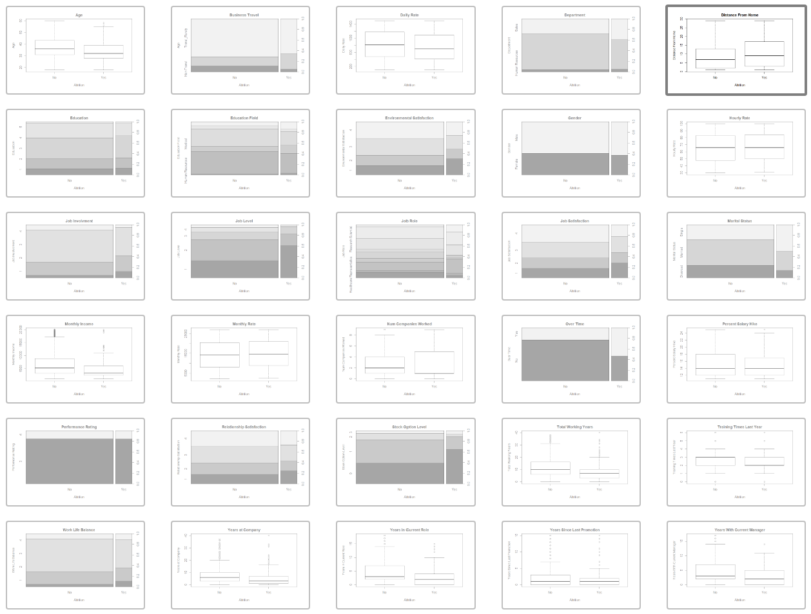

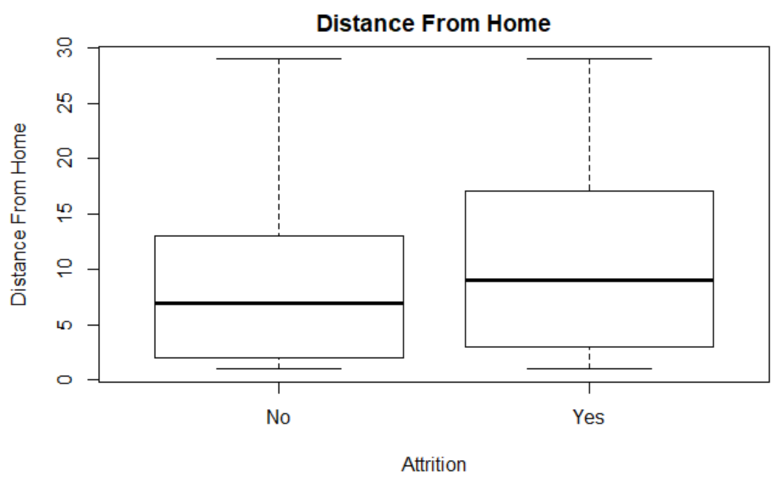
Exploratory Data analysis
Notes:
AMY
Each variable was evaluated against the Attrition segments of Yes and No for a preliminary search for attributes with significant differences between their Yes and Not to attrition segments.

Slide 9
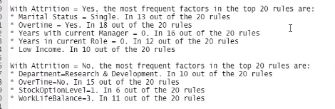
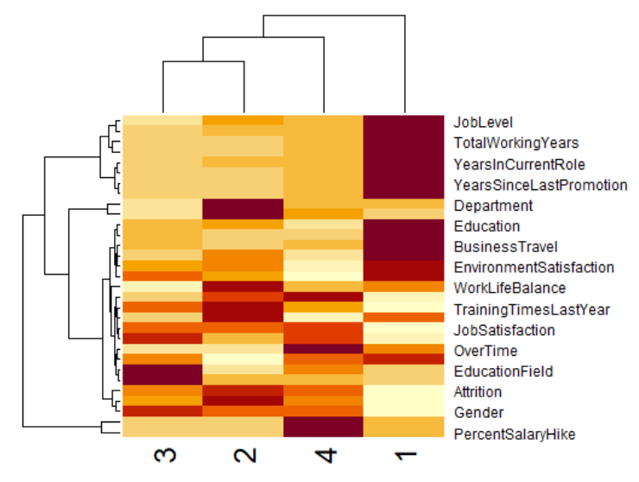
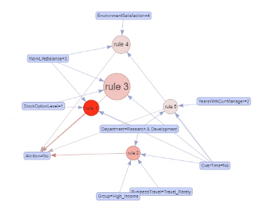
ARM
VISUALIZING GROUPS
Can we see patterns to inform which attributes to focus on?
K-means

Slide 10
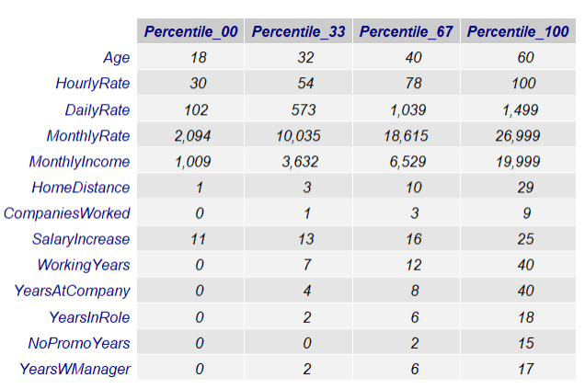
DISCRETIZATION Based on percentiles
Some models required the conversion of all attributes to factors and in some cases discretization. We used percentiles to determine the different levels. The resulting ranges/levels are shown
Notes:
This also provides a picture of the data and the dispersion for each attribute as it shows the min and max values for each one

Slide 11
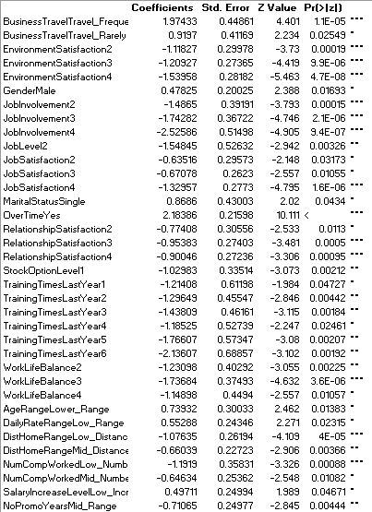
Logistic Regression
A preliminary assessment of attrition identifies as contributors Frequent Business Travel and Overtime.
"Reasons to stay" :
Environmental Satisfaction 2, 3, 4
Job Involvement 2, 3 and 4
Job Satisfaction 4
Relationship Satifaction 3 and 4
Work Life Balance 3
Low Distance from Home
Low number of companies worked for

Slide 12
Models
Decision Trees
- Depth 1,5,10
-Minsplit 5
Attrition
vs.
All Parameters
SVM
- All 4 Kernels
- Cost: .1, .3, .5, .7, 1
5 Seed Samples
Training: 66.7%
Testing: 33.3%
Average Accuracy
Average Precision-Yes Attrition
Average Precision-No Attrition
Average Recall-Yes Attrition
Average Recall-No Attrition
Attrition
vs.
Specific 10*
Naïve Bayes
- Laplace: 1
Attrition
vs.
Specific 10* + Income
KNN
- Nearest Neighbors: 3, 10
Attrition
vs.
Reduced Fields*
Random Forest
- Trees: 3, 5, 10, 15, 25
Specific 10**
* BusinessTravel
* Department
* Education
* JobLevel
* MaritalStatus
Reduced Fields**​ Specific 10 removing:​
-OverTime​
-Group​
-BusinessTravel
* MonthlyIncome​
* OverTime ​
* WorkLifeBalance​
* YearsWithCurrManager​
* YearsInCurrentRole
Notes:
We ran several modeling algorithms: Decision Trees, SVM, Naïve Bayes, KNN, Random Forest with tweaking parameters for each.
We tested across 4 versions of our datasets: all parameters, a specific 10 parameters, the 10 parameters with income added, and then the 10 parametres removing 3 parameters.
We quickly stopped using the Income and Reduced Fields set as Decision Trees did worse with them on accuracy, precision, and recall, so we chose to focus on all parameters and specific 10.
So the rest of the models, we targeted all parameters and specific 10. We created 5 seed samples (set the seeds so we could always guarantee the same) with 2/3 as training and 1/3 as testing, and we averaged the accuracy, precision, and recall across each 5 samples.

Slide 13
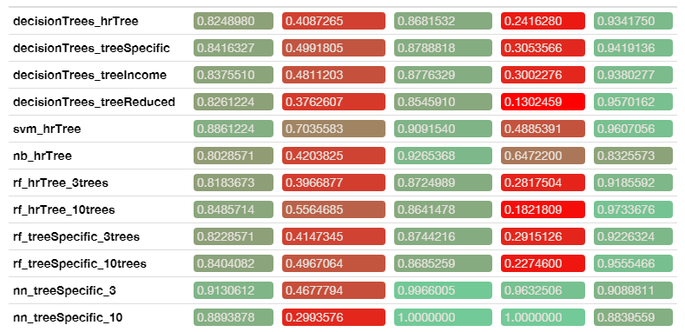
Model Results
Averages Across 5 Random Samples
Accuracy
Precision Yes
Precision No
Recall Yes
Recall No
The tradeoff between recall and precision
Would we rather have false positives (
(we think someone will leave, but they weren’t going to)
or false negatives
(we didn’t think they would leave, but they did)?
How to interpret:
SVM: from people who actually left, it guessed 70% of them…but partially because it guessed most people would leave.
KNN: 100% of the time it said “yes”, it was always right. But it made fewer guesses for “yes” at all.
Notes:
We aggregated the fields together, so we could better visualize model performance.
When we look at this, what we see is that each model does something better. We recommend focusing on the "Yes Attrition" because those are the people we want to target.

Slide 14
Key attributes
Attribute | EDA | ARM | KGT | K-means | glm | RandForest | Frequency
Overtime | x | x | x |  | x | x | 5
Environmental satisfaction | x |  |  | x | x | x | 4
Job level | x |  | x | x |  | x | 4
Marital status | x | x |  | x |  | x | 4
Monthly income | x | x |  | x |  | x | 4
Work-life balance | x | x |  |  | x | x | 4
Job Involvement | x |  |  | x | x |  | 3
Number companies worked at | x |  |  | x | x |  | 3
Stock option level | x | x |  | x |  |  | 3
Total working years | x |  |  | x |  | x | 3
Years in current role | x | x |  |  |  | x | 3
Years with current manager | x | x |  |  |  | x | 3
Job role |  |  | x | x |  | x | 3
Job satisfaction | x |  |  | x |  |  | 2
Relationship satisfaction | x |  |  |  | x |  | 2
Years at company | x |  |  |  |  | x | 2
Education |  |  |  | x |  | x | 2
Distance to home |  |  |  |  | x | x | 2
Training times last year | x |  |  |  |  |  | 1
Years in current company | x |  |  |  |  |  | 1
Department |  | x |  |  |  |  | 1
Business travel |  |  |  |  | x |  | 1
Age |  |  |  |  |  | X | 1
Daily rate |  |  |  |  |  | X | 1
Hourly rate |  |  |  |  |  | x | 1
What should HR create programs to influence?
We ran many models, and they identified many values as important.
The most common were: Overtime
Environmental satisfaction
Job level
Marital status
Monthly income
Work-life balance

Slide 15
Conclusions: For future analysis
More data leads to better results
Collect more observations, collect more attributes
Get a balanced sample.
Compare the models’ predictions with actual attrition to see what parameters they may have chosen to be groups
All models had some good qualities. We recommend continuing with:
KNN (very accurate at identifying who will quit but not ostensible for large data, and may need to have cutoffs based on timeframes)
SVM (very little processing work, scales well but doesn't really provide insight into what business variables to improve)
Random forest (good at handling a variety of attributes, provides attributes, but is less accurate)
Run the models on the new data every quarter

Slide 16
Conclusions: Business decisions
More data leads to better results
Collect other attributes that research has identified might have an impact, including on-boarding and networking
But the business also needs to consider:
How it wants to target at risk attrition employees: type 1 and type 2 errors and the costs associated with them – spend more money on employees who don't leave or let the employees leave
Improving employee experience for people influenced by key attributes (even if they haven’t been predicted to leave). The business can decide which of these they have the most influence over.
Ex: reduce overtime….or increase stock options?

